Slide 1

Lecture
on
“Advanced Computer Architecture –TCS 704”
by
Akansha Gupta
DEPARTMENT OF COMPUTER SCIENCE AND ENGINEERING
GRAPHIC ERA DEEMED TO BE UNIVERSITY – 248002

Slide 2
Control hazards & data hazards

Slide 3
Control Dependency (Branch Hazards)
This type of dependency occurs during the transfer of control instructions such as BRANCH, CALL, JMP, etc. On many instruction architectures, the processor will not know the target address of these instructions when it needs to insert the new instruction into the pipeline. Due to this, unwanted instructions are fed to the pipeline.
Consider the following sequence of instructions in the program: 100: I₁ 101: I₂ (JMP 250) 102: I₃ . . 250: BI₁
Expected output: I₁ -> I₂ -> BI₁

Slide 4
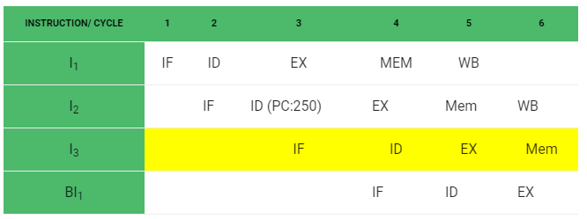
NOTE: Generally, the target address of the JMP instruction is known after ID stage only.
Output Sequence: I₁ -> I₂ -> I₃ -> BI₁
So, the output sequence is not equal to the expected output, that means the pipeline is not implemented correctly.

Slide 5
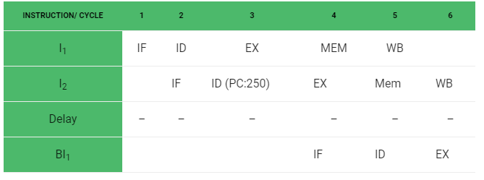
To correct the above problem we need to stop the Instruction fetch until we get target address of branch instruction. This can be implemented by introducing delay slot until we get the target address.
Output Sequence: I₁ -> I₂ -> Delay (Stall) -> BI₁
As the delay slot performs no operation, this output sequence is equal to the expected output sequence. But this slot introduces stall in the pipeline.

Slide 6
Solution for Control dependency
Branch Prediction is the method through which stalls due to control dependency can be eliminated. In this at 1st stage prediction is done about which branch will be taken. For branch prediction Branch penalty is zero.
Branch penalty : The number of stalls introduced during the branch operations in the pipelined processor is known as branch penalty.

Slide 7
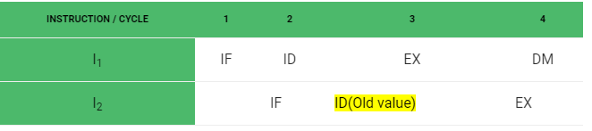
Data Dependency (Data Hazard)
Example: Let there be two instructions I1 and I2 such that: I1 : ADD R1, R2, R3 I2 : SUB R4, R1, R2
When the above instructions are executed in a pipelined processor, then data dependency condition will occur, which means that I₂ tries to read the data before I₁ writes it, therefore, I₂ incorrectly gets the old value from I₁.
To minimize data dependency stalls in the pipeline, operand forwarding is used.

Slide 8
Data Hazards
Data hazards occur when instructions that exhibit data dependence, modify data in different stages of a pipeline. Hazard cause delays in the pipeline. There are mainly three types of data hazards:
1) RAW (Read after Write) [Flow/True data dependency] 2) WAR (Write after Read) [Anti-Data dependency] 3) WAW (Write after Write) [Output data dependency]

Slide 9
Let there be two instructions I and J, such that J follow I. Then,
RAW hazard occurs when instruction J tries to read data before instruction I writes it. Eg: I: R2 <- R1 + R3 J: R4 <- R2 + R3
WAR hazard occurs when instruction J tries to write data before instruction I reads it. Eg: I: R2 <- R1 + R3 J: R3 <- R4 + R5
WAW hazard occurs when instruction J tries to write output before instruction I writes it. Eg: I: R2 <- R1 + R3 J: R2 <- R4 + R5
WAR and WAW hazards occur during the out-of-order execution of the instructions.

Slide 10
https://youtu.be/ckXMPWSClHw
thanks

